Slide 1

UNIT 1;
With you from the start
Modern family

Slide 2
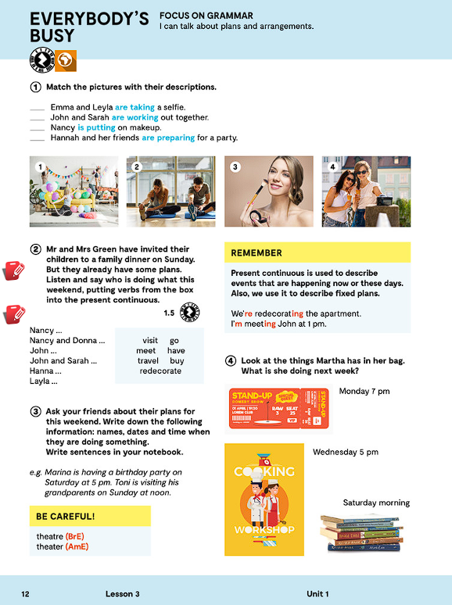
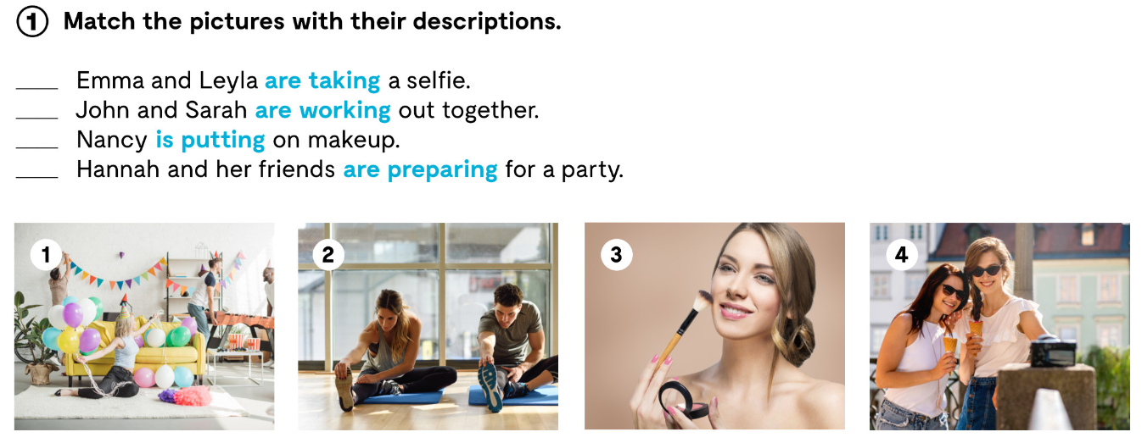
Look at the photos in task 1.
Match the pictures with their descriptions.
4
2
3
1

Slide 3
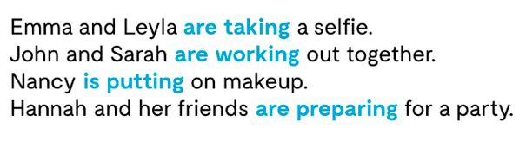


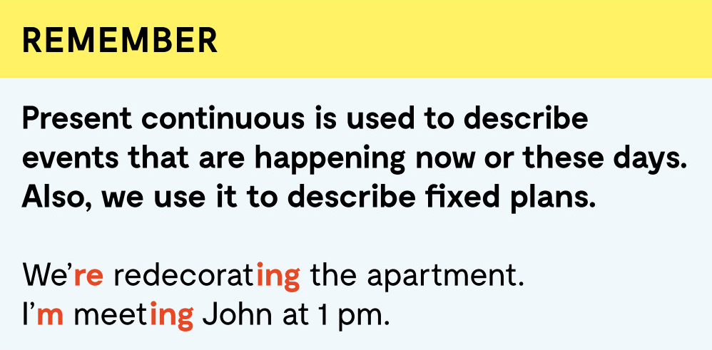
PRESENT CONTINUOUS
Ako glagol završava na jedan suglasnik ispred kojeg stoji kratak, naglašen samoglasnik, krajnji se suglasnik ispred –ing udvostručava:
stop – stopping
Slovo l se uvijek udvostručava:
travel – travelling
Ukoliko glagol završava na –e, to -e se gubi i dodaje se nastavak –ing:
come – coming
Ukoliko glagoli završavaju na –ie, nastavak prelazi u y i dodaje se nastavak –ing:
die – dying

Slide 4
Prilikom izražavanja negacije, pravilo je da se između pomoćnog glagola TO BE i glavnog glagola stavlja negacija not.
I am not doing my homework at the moment.
Kod upitnog oblika, pomoćni glagol TO BE mijenja mjesto sa subjektom, odnosno vršiteljem radnje, dok ostatak rečenice ostaje nepromijenjen.
You are cooking.
Are you cooking?
What are you cooking?

Slide 5

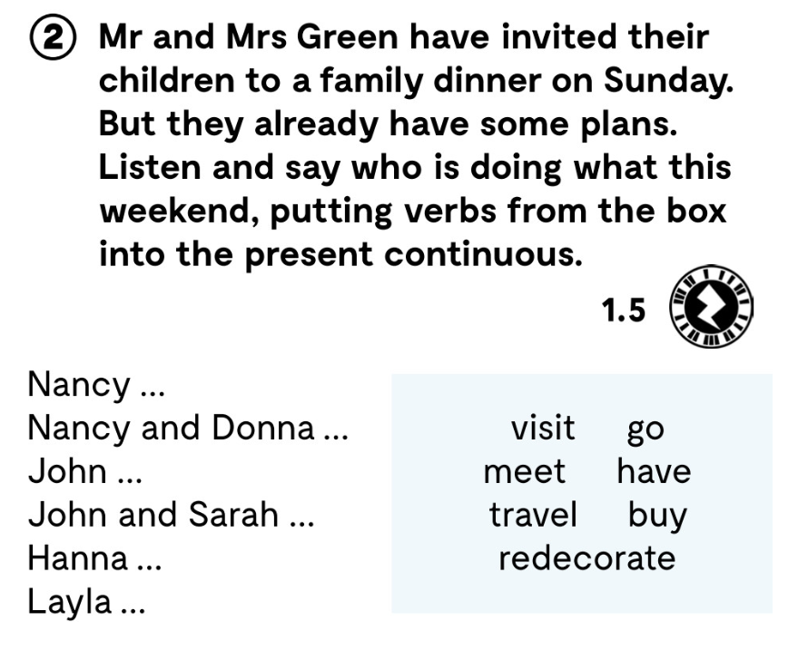
plans planovi
arrangements dogovori
schedule raspored
redecorate preurediti
apartment stan
go hiking otići na planinarenje
dinner večera
diner restoran, zalogajnica
https://www.e-sfera.hr/dodatni-digitalni-sadrzaji/8b293713-f80a-4e98-b77e-6eb7616017a4/assets/audio/03_u1__l3_family_dinner_1.mp3

Slide 6
Nancy is visiting her friend Donna.
Nancy and Donna are going hiking.
John is meeting Sarah’s parents.
John and Sarah are having dinner.
Hanna is travelling to London.
Layla is redecorating her apartment.

Slide 7
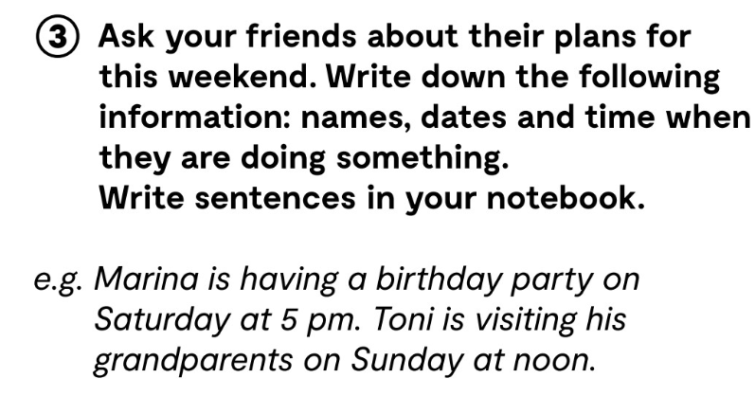

Slide 8
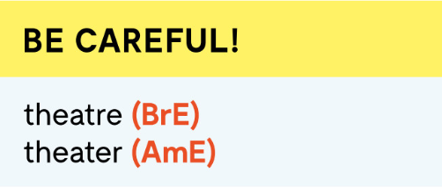
Evo još nekih riječi koje se u pisanju razlikuju u britanskom i američkom engleskom:
colour color
neighbour neighbor
programme program
kilometre kilometer
Neke riječi su u potpunosti različite:
apartment flat
mobile phone cell phone
car park parking lot
chemist drugstore
primary school elementary school
holiday vacation

Slide 9
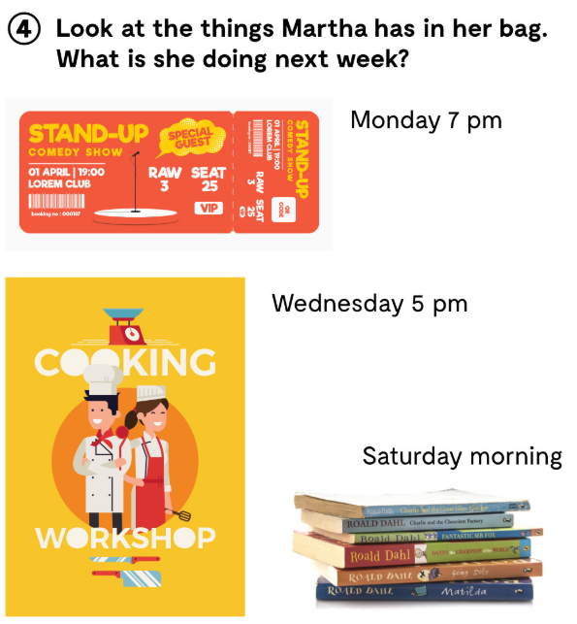

Slide 10
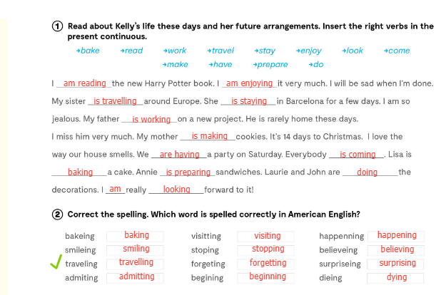

Slide 11
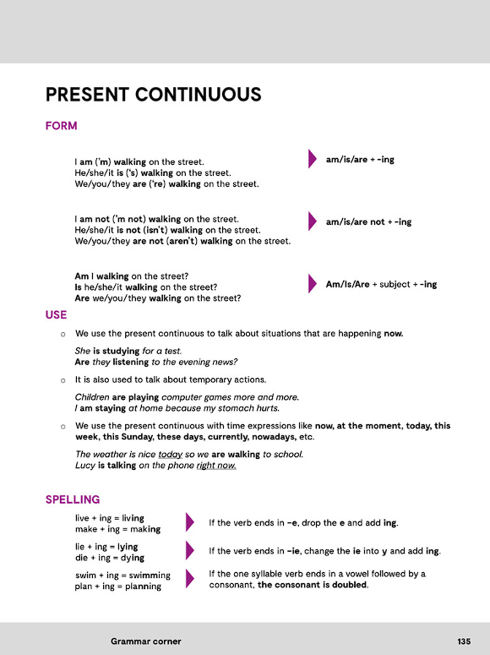
GRAMMAR CORNER, p135. :
Practise:
https://learningapps.org/watch?v=ppp5ieqtc20

Slide 12
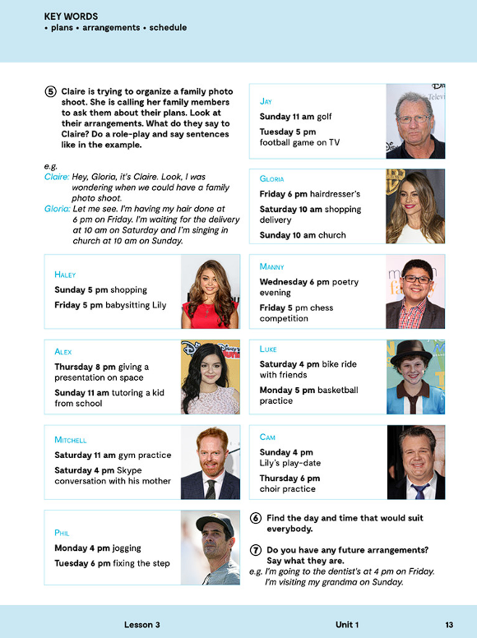

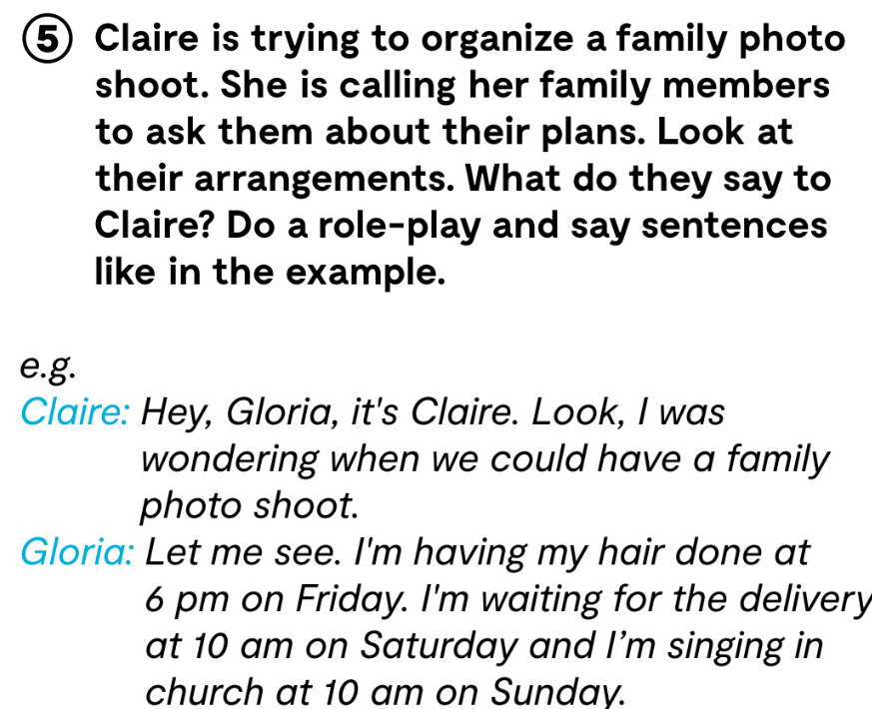
Hailey: Let me see. I’m going shopping at 5 pm on Sunday
and I’m babysitting Lily at 5pm on Friday.

Slide 13
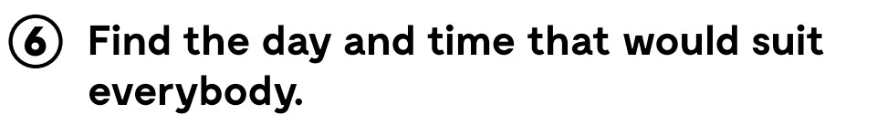
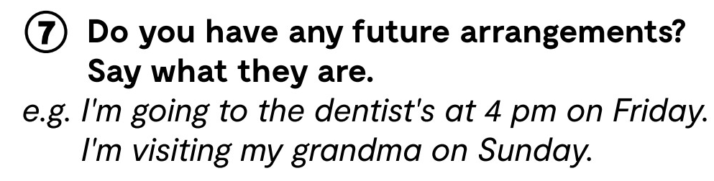

Slide 14
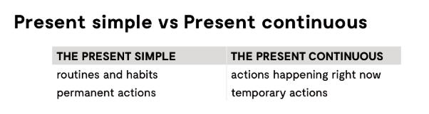
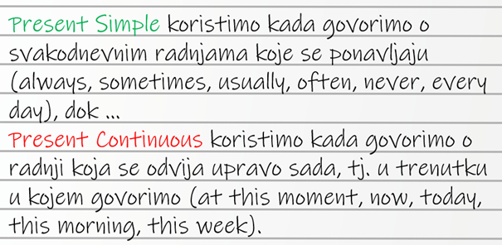

Slide 15
